Slide 1
A Study in Birthrate Mortality
Parris Burton | Mamadou Diallo | Kathryn Davis | Tim McCarthy
Project Description
Investigate birthrates by state and dig into state/region of the country as well as socioeconomic factors that are impacting mortality of mother and or child.
Questions to Be Answered
Is there a signal between maternal and infant death rates? Kathryn Davis
What state has the highest and lowest infant mortality rate? Parris Burton
TM: How does poverty rate affect the maternal mortality rate? Tim McCarthy
MD: Does race factor into infant or maternal mortality rates? Mamadou Dialli
Datasets used
Census API - https://www.census.gov/data/developers/data-sets.html
CDC CSV Data – https://open.cdc.gov/apis.html

Slide 2
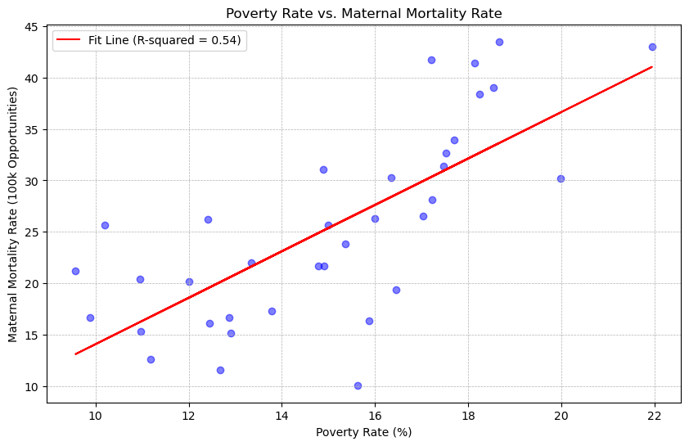
Socioeconomic Impact on Maternal Mortality
Tim McCarthy
Overall Poverty Rate by Maternal Mortality Rate
State Averages
Using state averages for both poverty rate and maternal mortality rate during and after childbirth
It is clear that there is a direct correlation between the poverty rate in a state and the instances of maternal mortality.
R-squared is 0.54 showing a strong positive correlation between poverty rate and maternal mortality.

Slide 3
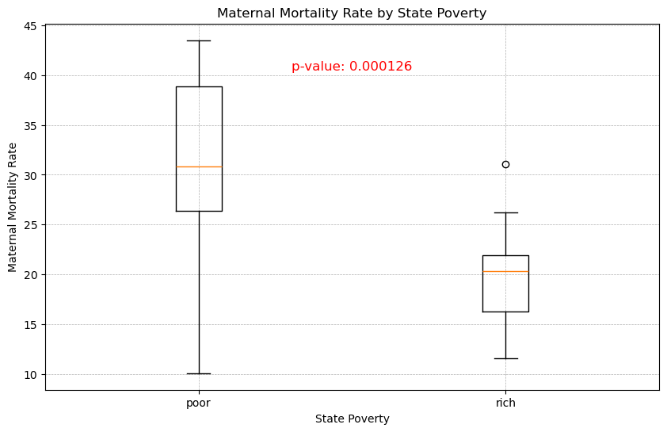
Socioeconomic Impact on Maternal Mortality
Tim McCarthy
Comparison Between Poor and Rich States on Maternal Mortality
Combining the 25 poorer states with the 25 richer states, the mortality rate stands out even further.
Women in the poorer states are at a 65% higher risk of maternal death than women in richer states.
P-value is less than 0.05, so we can reject the null hypothesis and assume these samples are statistically significant

Slide 4
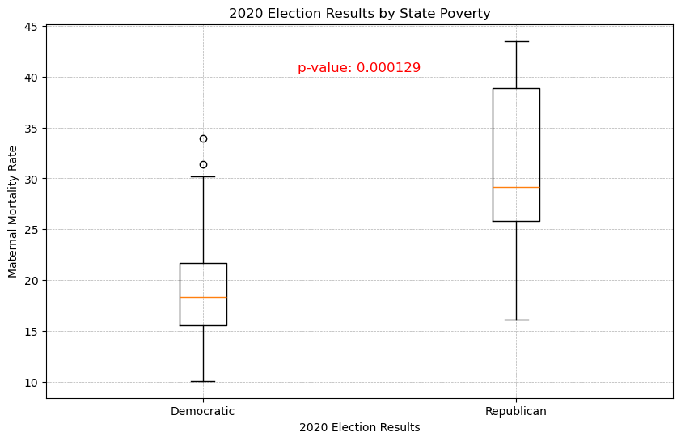
Socioeconomic Impact on Maternal Mortality
Tim McCarthy
Comparison Between Red and Blue States on Maternal Mortality
Using data from 2020 presidential election, data was split between Republican and Democratic states.
Women in the poorer states are almost twice as at risk of maternal death than women in richer states.
P-value is less than 0.05, so we can reject the null hypothesis and assume these samples are statistically significant

